Slide 2




IMPLEMENTING ENTERPRISE STRUCTURE SETUP AND MANAGEMENT FOR PRIME INSURANCE COMPANY USING ORACLE HCM EBS
Chairman

Slide 3

MEET OUR CLIENT

Slide 4


ORGANIZATIONAL CHART
MEET OUR CLIENT

Slide 5
ORGANIZATIONAL CHART
MEET OUR CLIENT

Slide 6
MEET OUR CLIENT
ORGANIZATIONAL CHART
Chairman

Slide 7
Chairman
ORGANIZATIONAL CHART
Chief Executive Officer (CEO)
Chief Claims Officer (CCO)
Chief Risk Officer CRO
Chief Commercial Officer (CCO)
Chief Information Officer (CIO)
Chief Financial Officer (CFO)
Chief Operations Officer (COO)
Claims Department
Chief Actuarial Officer (CAO)
Chief Underwriting Officer (CUO)
Marketing Department
Sales Department
Business Development
IT Department
Support Department
Finance and Accounting Department
Customer Service Department
Auditing Department
Legal Compliance Department
Administration
Human Resources Department
Claims Director
Actuarial Department
Underwriting Director
Marketing Director
Sales Director
Business Development Director
IT Manager
Support Manager
Financial Director
Customer Service Director
Internal Audit Director
General Counsel
Administration Director
HR Director
Claims Supervisor
Actuarial Director
Underwriting Manager
Marketing Manager
Sales Manager
Business Development Manager
IT Supervisor
Support Supervisor
Financial Manager
Customer Service Manager
Audit Manager
Deputy General Counsel
Legal Compliance Manager
Branch Manager
Admin Assistants
HR Business Partner
Claims Team Leads
Actuarial Supervisor
Underwriting Supervisor
Marketing Supervisor
Sales Supervisor
Business Development Associate
IT Team Leads
Support Team Leads
Financial Supervisor
Customer Service Supervisor
Lead Auditor
Legal Compliance Specialists
Coordinators
Support Functions
Compensation and Benefits Manager
Claims Adjustors and Investigations
Actuarial Associate
Underwriting Team Leads
Marketing Team Leads
Sales Team Leads
Business Development Representative
Developers
Support Engineers
Financial Analysts
Customer Service Team Leads
Audit Associates
Legal Compliance Assistants
Collections
Recruitment and Talent Acquisition Manager
Couriers and Office Boys
Actuaries
Underwriters
Marketing Specialist
Salespeople
Market Research Analyst
Accountants
Customer Service Agents
L&D Manager
Employee Relations Manager
Payroll Manager
HR Generalist
HR Administrators
HR Assistants

Slide 8
Chairman
Chief Executive Officer (CEO)
Chief Claims Officer (CCO)
Chief Risk Officer (CRO)
Chief Commercial Officer (CCO)
Chief Information Officer (CIO)
Chief Financial Officer (CFO)
Chief Operations Officer (COO)
Claims Department
Chief Actuarial Officer (CAO)
Chief Underwriting Officer (CUO)
Marketing Department
Sales Department
Business Development
IT Department
Support Department
Finance and Accounting Department
Customer Service Department
Auditing Department
Legal Compliance Department
Administration
Human Resources Department
Claims Director
Actuarial Department
Underwriting Director
Marketing Director
Sales Director
Business Development Director
IT Manager
Support Manager
Financial Director
Customer Service Director
Internal Audit Director
General Counsel
Administration Director
HR Director
Claims Supervisor
Actuarial Director
Underwriting Manager
Marketing Manager
Sales Manager
Business Development Manager
IT Supervisor
Support Supervisor
Financial Manager
Customer Service Manager
Audit Manager
Deputy General Counsel
Legal Compliance Manager
Branch Manager
Admin Assistants
HR Business Partner
Claims Team Leads
Actuarial Supervisor
Underwriting Supervisor
Marketing Supervisor
Sales Supervisor
Business Development Associate
IT Team Leads
Support Team Leads
Financial Supervisor
Customer Service Supervisor
Lead Auditor
Legal Compliance Specialists
Coordinators
Support Functions
Compensation and Benefits Manager
Claims Adjustors and Investigations
Actuarial Associate
Underwriting Team Leads
Marketing Team Leads
Sales Team Leads
Business Development Representative
Developers
Support Engineers
Financial Analysts
Customer Service Team Leads
Audit Associates
Legal Compliance Assistants
Collections
Recruitment and Talent Acquisition Manager
Couriers and Office Boys
Actuaries
Underwriters
Marketing Specialist
Salespeople
Market Research Analyst
Accountants
Customer Service Agents
L&D Manager
Employee Relations Manager
Payroll Manager
HR Generalist
HR Administrators
HR Assistants

Slide 9
Chairman
Chief Executive Officer (CEO)
Chief Claims Officer (CCO)
Chief Risk Officer (CRO)
Chief Commercial Officer (CCO)
Chief Information Officer (CIO)
Chief Financial Officer (CFO)
Chief Operations Officer (COO)
Claims Department
Chief Actuarial Officer (CAO)
Chief Underwriting Officer (CUO)
Marketing Department
Sales Department
Business Development
IT Department
Support Department
Finance and Accounting Department
Customer Service Department
Auditing Department
Legal Compliance Department
Administration
Human Resources Department
Claims Director
Actuarial Department
Underwriting Director
Marketing Director
Sales Director
Business Development Director
IT Manager
Support Manager
Financial Director
Customer Service Director
Internal Audit Director
General Counsel
Administration Director
HR Director
Claims Supervisor
Actuarial Director
Underwriting Manager
Marketing Manager
Sales Manager
Business Development Manager
IT Supervisor
Support Supervisor
Financial Manager
Customer Service Manager
Audit Manager
HR Business Partner
Claims Team Leads
Deputy General Counsel
Legal Compliance Manager
Branch Manager
Admin Assistants
Actuarial Supervisor
Underwriting Supervisor
Marketing Supervisor
Sales Supervisor
Business Development Associate
IT Team Leads
Support Team Leads
Financial Supervisor
Customer Service Supervisor
Lead Auditor
Legal Compliance Specialists
Coordinators
Support Functions
Compensation and Benefits Manager
Claims Adjustors and Investigations
Actuarial Associate
Underwriting Team Leads
Marketing Team Leads
Sales Team Leads
Business Development Representative
Developers
Support Engineers
Financial Analysts
Customer Service Team Leads
Audit Associates
Recruitment and Talent Acquisition Manager
Legal Compliance Assistants
Collections
Couriers and Office Boys
Actuaries
Underwriters
Marketing Specialist
Salespeople
Market Research Analyst
Accountants
Customer Service Agents
L&D Manager
Employee Relations Manager
Payroll Manager
HR Generalist
HR Administrators
HR Assistants

Slide 10
E-BUSINESS SUITE
Chairman
Chief Executive Officer (CEO)
Chief Claims Officer (CCO)
Chief Risk Officer (CRO)
Chief Commercial Officer (CCO)
Chief Information Officer (CIO)
Chief Financial Officer (CFO)
Chief Operations Officer (COO)
Chief Actuarial Officer (CAO)
Chief Underwriting Officer (CUO)
Marketing Department
Sales Department
Business Development
IT Department
Support Department
Finance and Accounting Department
Customer Service Department
Auditing Department
Legal Compliance Department
Administration
Human Resources Department
Claims Department
Actuarial Department
Underwriting Director
Marketing Director
Sales Director
Business Development Director
IT Manager
Support Manager
Financial Director
Customer Service Director
Internal Audit Director
General Counsel
Administration Director
HR Director
Actuarial Director
Underwriting Manager
Marketing Manager
Sales Manager
Business Development Manager
IT Supervisor
Support Supervisor
Financial Manager
Customer Service Manager
Audit Manager
Deputy General Counsel
Legal Compliance Manager
Branch Manager
Admin Assistants
HR Business Partner
Claims Director
Actuarial Supervisor
Underwriting Supervisor
Marketing Supervisor
Sales Supervisor
Business Development Associate
IT Team Leads
Support Team Leads
Financial Supervisor
Customer Service Supervisor
Lead Auditor
Legal Compliance Specialists
Coordinators
Support Functions
Compensation and Benefits Manager
Actuarial Associate
Underwriting Team Leads
Marketing Team Leads
Sales Team Leads
Business Development Representative
Developers
Support Engineers
Financial Analysts
Customer Service Team Leads
Audit Associates
Legal Compliance Assistants
Recruitment and Talent Acquisition Manager
Collections
Couriers and Office Boys
Actuaries
Underwriters
Marketing Specialist
Salespeople
Market Research Analyst
Accountants
Customer Service Agents
L&D Manager
Claims Supervisor
Employee Relations Manager
Payroll Manager
Claims Team Leads
HR Generalist
HR Administrators
Claims Adjustors and Investigations
HR Assistants

Slide 11
E-BUSINESS SUITE
Chairman
Chief Executive Officer (CEO)
Chief Claims Officer (CCO)
Chief Risk Officer (CRO)
Chief Commercial Officer (CCO)
Chief Information Officer (CIO)
Chief Financial Officer (CFO)
Chief Operations Officer (COO)
Claims Department
Marketing Department
Sales Department
Business Development
IT Department
Support Department
Finance and Accounting Department
Customer Service Department
Auditing Department
Legal Compliance Department
Administration
Human Resources Department
Claims Director
Chief Actuarial Officer (CAO)
Chief Underwriting Officer (CUO)
Marketing Director
Sales Director
Business Development Director
IT Manager
Support Manager
Financial Director
Customer Service Director
Internal Audit Director
General Counsel
Administration Director
HR Director
Claims Supervisor
Marketing Manager
Sales Manager
Business Development Manager
IT Supervisor
Support Supervisor
Financial Manager
Customer Service Manager
Audit Manager
HR Business Partner
Claims Team Leads
Deputy General Counsel
Legal Compliance Manager
Branch Manager
Admin Assistants
Marketing Supervisor
Sales Supervisor
Business Development Associate
IT Team Leads
Support Team Leads
Financial Supervisor
Customer Service Supervisor
Lead Auditor
Legal Compliance Specialists
Coordinators
Support Functions
Compensation and Benefits Manager
Claims Adjustors and Investigations
Actuarial Department
Underwriting Director
Marketing Team Leads
Sales Team Leads
Business Development Representative
Developers
Support Engineers
Financial Analysts
Customer Service Team Leads
Audit Associates
Recruitment and Talent Acquisition Manager
Legal Compliance Assistants
Collections
Couriers and Office Boys
Marketing Specialist
Salespeople
Market Research Analyst
Accountants
Customer Service Agents
L&D Manager
Actuarial Director
Underwriting Manager
Employee Relations Manager
Payroll Manager
Actuarial Supervisor
Underwriting Supervisor
HR Generalist
HR Administrators
Actuarial Associate
Underwriting Team Leads
HR Assistants
Actuaries
Underwriters

Slide 12
E-BUSINESS SUITE
Chairman
Chief Executive Officer (CEO)
Chief Claims Officer (CCO)
Chief Risk Officer (CRO)
Chief Commercial Officer (CCO)
Chief Information Officer (CIO)
Chief Financial Officer (CFO)
Chief Operations Officer (COO)
Claims Department
Chief Actuarial Officer (CAO)
Chief Underwriting Officer (CUO)
IT Department
Support Department
Finance and Accounting Department
Customer Service Department
Auditing Department
Legal Compliance Department
Administration
Human Resources Department
Claims Director
Actuarial Department
Underwriting Director
IT Manager
Support Manager
Financial Director
Customer Service Director
Internal Audit Director
General Counsel
Administration Director
HR Director
Claims Supervisor
Marketing Department
Sales Department
Business Development
Actuarial Director
Underwriting Manager
IT Supervisor
Support Supervisor
Financial Manager
Customer Service Manager
Audit Manager
Deputy General Counsel
Legal Compliance Manager
Branch Manager
Admin Assistants
HR Business Partner
Claims Team Leads
Actuarial Supervisor
Underwriting Supervisor
IT Team Leads
Support Team Leads
Financial Supervisor
Customer Service Supervisor
Lead Auditor
Compensation and Benefits Manager
Claims Adjustors and Investigations
Legal Compliance Specialists
Coordinators
Support Functions
Actuarial Associate
Underwriting Team Leads
Marketing Director
Sales Director
Business Development Director
Developers
Support Engineers
Financial Analysts
Customer Service Team Leads
Audit Associates
Legal Compliance Assistants
Collections
Recruitment and Talent Acquisition Manager
Actuaries
Underwriters
Accountants
Customer Service Agents
Couriers and Office Boys
L&D Manager
Marketing Manager
Sales Manager
Business Development Manager
Employee Relations Manager
Payroll Manager
HR Generalist
Marketing Supervisor
Sales Supervisor
Business Development Associate
HR Administrators
HR Assistants
Marketing Team Leads
Sales Team Leads
Business Development Representative
Marketing Specialist
Salespeople
Market Research Analyst

Slide 13
E-BUSINESS SUITE
Chairman
Chief Executive Officer (CEO)
Chief Claims Officer (CCO)
Chief Risk Officer (CRO)
Chief Commercial Officer (CCO)
Chief Information Officer (CIO)
Chief Financial Officer (CFO)
Chief Operations Officer (COO)
Claims Department
Chief Actuarial Officer (CAO)
Chief Underwriting Officer (CUO)
Marketing Department
Sales Department
Business Development
Finance and Accounting Department
Customer Service Department
Auditing Department
Legal Compliance Department
Administration
Human Resources Department
Claims Director
Actuarial Department
Underwriting Director
Marketing Director
Sales Director
Business Development Director
Financial Director
Customer Service Director
Internal Audit Director
General Counsel
Administration Director
HR Director
Claims Supervisor
IT Department
Support Department
Actuarial Director
Underwriting Manager
Marketing Manager
Sales Manager
Business Development Manager
Financial Manager
Customer Service Manager
Audit Manager
Deputy General Counsel
Legal Compliance Manager
Branch Manager
Admin Assistants
HR Business Partner
Claims Team Leads
Actuarial Supervisor
Underwriting Supervisor
Marketing Supervisor
Sales Supervisor
Business Development Associate
Financial Supervisor
Customer Service Supervisor
Lead Auditor
Compensation and Benefits Manager
Claims Adjustors and Investigations
Legal Compliance Specialists
Coordinators
Support Functions
Actuarial Associate
Underwriting Team Leads
Marketing Team Leads
Sales Team Leads
Business Development Representative
IT Manager
Support Manager
Financial Analysts
Customer Service Team Leads
Audit Associates
Legal Compliance Assistants
Recruitment and Talent Acquisition Manager
Actuaries
Underwriters
Marketing Specialist
Salespeople
Market Research Analyst
Accountants
Customer Service Agents
Collections
Couriers and Office Boys
L&D Manager
IT Supervisor
Support Supervisor
Employee Relations Manager
Payroll Manager
HR Generalist
IT Team Leads
Support Team Leads
HR Administrators
HR Assistants
Developers
Support Engineers

Slide 14
Chairman
E-BUSINESS SUITE
Chief Executive Officer (CEO)
Chief Claims Officer (CCO)
Chief Risk Officer (CRO)
Chief Commercial Officer (CCO)
Chief Information Officer (CIO)
Chief Financial Officer (CFO)
Chief Operations Officer (COO)
Claims Department
Chief Actuarial Officer (CAO)
Chief Underwriting Officer (CUO)
Marketing Department
Sales Department
Business Development
IT Department
Support Department
Customer Service Department
Auditing Department
Legal Compliance Department
Administration
Human Resources Department
Claims Director
Actuarial Department
Underwriting Director
Marketing Director
Sales Director
Business Development Director
IT Manager
Support Manager
Customer Service Director
Internal Audit Director
General Counsel
Administration Director
HR Director
Claims Supervisor
Finance and Accounting Department
Actuarial Director
Underwriting Manager
Marketing Manager
Sales Manager
Business Development Manager
IT Supervisor
Support Supervisor
Customer Service Manager
Audit Manager
Deputy General Counsel
Legal Compliance Manager
Branch Manager
Admin Assistants
HR Business Partner
Claims Team Leads
Actuarial Supervisor
Underwriting Supervisor
Marketing Supervisor
Sales Supervisor
Business Development Associate
IT Team Leads
Support Team Leads
Customer Service Supervisor
Lead Auditor
Compensation and Benefits Manager
Claims Adjustors and Investigations
Legal Compliance Specialists
Coordinators
Support Functions
Actuarial Associate
Underwriting Team Leads
Marketing Team Leads
Sales Team Leads
Business Development Representative
Developers
Support Engineers
Financial Director
Customer Service Team Leads
Audit Associates
Legal Compliance Assistants
Recruitment and Talent Acquisition Manager
Collections
Couriers and Office Boys
Actuaries
Underwriters
Marketing Specialist
Salespeople
Market Research Analyst
Customer Service Agents
L&D Manager
Financial Manager
Employee Relations Manager
Payroll Manager
HR Generalist
Financial Supervisor
HR Administrators
HR Assistants
Financial Analysts
Accountants

Slide 15
E-BUSINESS SUITE
Chairman
Chief Executive Officer (CEO)
Chief Claims Officer (CCO)
Chief Risk Officer (CRO)
Chief Commercial Officer (CCO)
Chief Information Officer (CIO)
Chief Financial Officer (CFO)
Chief Operations Officer (COO)
Claims Department
Chief Actuarial Officer (CAO)
Chief Underwriting Officer (CUO)
Marketing Department
Sales Department
Business Development
IT Department
Support Department
Finance and Accounting Department
Claims Director
Actuarial Department
Underwriting Director
Marketing Director
Sales Director
Business Development Director
IT Manager
Support Manager
Financial Director
Customer Service Department
Auditing Department
Legal Compliance Department
Administration
Human Resources Department
Claims Supervisor
Actuarial Director
Underwriting Manager
Marketing Manager
Sales Manager
Business Development Manager
IT Supervisor
Support Supervisor
Financial Manager
Claims Team Leads
Actuarial Supervisor
Underwriting Supervisor
Marketing Supervisor
Sales Supervisor
Business Development Associate
IT Team Leads
Support Team Leads
Financial Supervisor
Customer Service Director
Internal Audit Director
General Counsel
Administration Director
HR Director
Claims Adjustors and Investigations
Actuarial Associate
Underwriting Team Leads
Marketing Team Leads
Sales Team Leads
Business Development Representative
Developers
Support Engineers
Financial Analysts
Customer Service Manager
Audit Manager
HR Business Partner
Actuaries
Underwriters
Marketing Specialist
Salespeople
Market Research Analyst
Accountants
Customer Service Supervisor
Lead Auditor
Deputy General Counsel
Legal Compliance Manager
Branch Manager
Admin Assistants
Compensation and Benefits Manager
Customer Service Team Leads
Audit Associates
Legal Compliance Specialists
Coordinators
Support Functions
Recruitment and Talent Acquisition Manager
Customer Service Agents
Legal Compliance Assistants
L&D Manager
Collections
Couriers and Office Boys
Employee Relations Manager
Payroll Manager
HR Generalist
HR Administrators
HR Assistants

Slide 16
E-BUSINESS SUITE
Chairman
Chief Executive Officer (CEO)
Chief Claims Officer (CCO)
Chief Risk Officer (CRO)
Chief Commercial Officer (CCO)
Chief Information Officer (CIO)
Chief Financial Officer (CFO)
Chief Operations Officer (COO)
Claims Department
Chief Actuarial Officer (CAO)
Chief Underwriting Officer (CUO)
Marketing Department
Sales Department
Business Development
IT Department
Support Department
Finance and Accounting Department
Claims Director
Actuarial Department
Underwriting Director
Marketing Director
Sales Director
Business Development Director
IT Manager
Support Manager
Financial Director
Customer Service Department
Auditing Department
Legal Compliance Department
Administration
Human Resources Department
Claims Supervisor
Actuarial Director
Underwriting Manager
Marketing Manager
Sales Manager
Business Development Manager
IT Supervisor
Support Supervisor
Financial Manager
Internal Audit Director
General Counsel
Administration Director
HR Director
Claims Team Leads
Actuarial Supervisor
Underwriting Supervisor
Marketing Supervisor
Sales Supervisor
Business Development Associate
IT Team Leads
Support Team Leads
Financial Supervisor
Customer Service Director
Audit Manager
Deputy General Counsel
Legal Compliance Manager
HR Business Partner
Branch Manager
Admin Assistants
Claims Adjustors and Investigations
Actuarial Associate
Underwriting Team Leads
Marketing Team Leads
Sales Team Leads
Business Development Representative
Developers
Support Engineers
Financial Analysts
Lead Auditor
Legal Compliance Specialists
Compensation and Benefits Manager
Coordinators
Support Functions
Actuaries
Underwriters
Marketing Specialist
Salespeople
Market Research Analyst
Accountants
Customer Service Manager
Audit Associates
Legal Compliance Assistants
Collections
Recruitment and Talent Acquisition Manager
Couriers and Office Boys
L&D Manager
Customer Service Supervisor
Employee Relations Manager
Payroll Manager
Customer Service Team Leads
HR Generalist
HR Administrators
Customer Service Agents
HR Assistants

Slide 17
E-BUSINESS SUITE
Chairman
Chief Executive Officer (CEO)
Chief Claims Officer (CCO)
Chief Risk Officer (CRO)
Chief Commercial Officer (CCO)
Chief Information Officer (CIO)
Chief Financial Officer (CFO)
Chief Operations Officer (COO)
Claims Department
Chief Actuarial Officer (CAO)
Chief Underwriting Officer (CUO)
Marketing Department
Sales Department
Business Development
IT Department
Support Department
Finance and Accounting Department
Claims Director
Actuarial Department
Underwriting Director
Marketing Director
Sales Director
Business Development Director
IT Manager
Support Manager
Financial Director
Customer Service Department
Auditing Department
Legal Compliance Department
Administration
Human Resources Department
Claims Supervisor
Actuarial Director
Underwriting Manager
Marketing Manager
Sales Manager
Business Development Manager
IT Supervisor
Support Supervisor
Financial Manager
Customer Service Director
General Counsel
Administration Director
HR Director
Claims Team Leads
Actuarial Supervisor
Underwriting Supervisor
Marketing Supervisor
Sales Supervisor
Business Development Associate
IT Team Leads
Support Team Leads
Financial Supervisor
Customer Service Manager
HR Business Partner
Claims Adjustors and Investigations
Internal Audit Director
Deputy General Counsel
Legal Compliance Manager
Branch Manager
Admin Assistants
Actuarial Associate
Underwriting Team Leads
Marketing Team Leads
Sales Team Leads
Business Development Representative
Developers
Support Engineers
Financial Analysts
Customer Service Supervisor
Legal Compliance Specialists
Coordinators
Support Functions
Compensation and Benefits Manager
Actuaries
Underwriters
Marketing Specialist
Salespeople
Market Research Analyst
Accountants
Customer Service Team Leads
Audit Manager
Legal Compliance Assistants
Recruitment and Talent Acquisition Manager
Collections
Couriers and Office Boys
Customer Service Agents
L&D Manager
Lead Auditor
Employee Relations Manager
Payroll Manager
Audit Associates
HR Generalist
HR Administrators
HR Assistants

Slide 18
E-BUSINESS SUITE
Chairman
Chief Executive Officer (CEO)
Chief Claims Officer (CCO)
Chief Risk Officer (CRO)
Chief Commercial Officer (CCO)
Chief Information Officer (CIO)
Chief Financial Officer (CFO)
Chief Operations Officer (COO)
Claims Department
Chief Actuarial Officer (CAO)
Chief Underwriting Officer (CUO)
Marketing Department
Sales Department
Business Development
IT Department
Support Department
Finance and Accounting Department
Claims Director
Actuarial Department
Underwriting Director
Marketing Director
Sales Director
Business Development Director
IT Manager
Support Manager
Financial Director
Customer Service Department
Auditing Department
Legal Compliance Department
Administration
Human Resources Department
Claims Supervisor
Actuarial Director
Underwriting Manager
Marketing Manager
Sales Manager
Business Development Manager
IT Supervisor
Support Supervisor
Financial Manager
Customer Service Director
Internal Audit Director
Administration Director
HR Director
Claims Team Leads
Actuarial Supervisor
Underwriting Supervisor
Marketing Supervisor
Sales Supervisor
Business Development Associate
IT Team Leads
Support Team Leads
Financial Supervisor
Customer Service Manager
Audit Manager
General Counsel
Branch Manager
Admin Assistants
HR Business Partner
Claims Adjustors and Investigations
Actuarial Associate
Underwriting Team Leads
Marketing Team Leads
Sales Team Leads
Business Development Representative
Developers
Support Engineers
Financial Analysts
Customer Service Supervisor
Lead Auditor
Coordinators
Support Functions
Compensation and Benefits Manager
Actuaries
Underwriters
Marketing Specialist
Salespeople
Market Research Analyst
Accountants
Customer Service Team Leads
Audit Associates
Recruitment and Talent Acquisition Manager
Deputy General Counsel
Legal Compliance Manager
Collections
Couriers and Office Boys
Customer Service Agents
L&D Manager
Employee Relations Manager
Legal Compliance Specialists
Payroll Manager
Legal Compliance Assistants
HR Generalist
HR Administrators
HR Assistants

Slide 19
E-BUSINESS SUITE
Chairman
Chief Executive Officer (CEO)
Chief Claims Officer (CCO)
Chief Risk Officer (CRO)
Chief Commercial Officer (CCO)
Chief Information Officer (CIO)
Chief Financial Officer (CFO)
Chief Operations Officer (COO)
Claims Department
Chief Actuarial Officer (CAO)
Chief Underwriting Officer (CUO)
Marketing Department
Sales Department
Business Development
IT Department
Support Department
Finance and Accounting Department
Claims Director
Actuarial Department
Underwriting Director
Marketing Director
Sales Director
Business Development Director
IT Manager
Support Manager
Financial Director
Customer Service Department
Auditing Department
Legal Compliance Department
Administration
Human Resources Department
Claims Supervisor
Actuarial Director
Underwriting Manager
Marketing Manager
Sales Manager
Business Development Manager
IT Supervisor
Support Supervisor
Financial Manager
Claims Team Leads
Customer Service Director
Internal Audit Director
General Counsel
HR Director
Actuarial Supervisor
Underwriting Supervisor
Marketing Supervisor
Sales Supervisor
Business Development Associate
IT Team Leads
Support Team Leads
Financial Supervisor
Customer Service Manager
Audit Manager
Administration Director
HR Business Partner
Claims Adjustors and Investigations
Actuarial Associate
Underwriting Team Leads
Marketing Team Leads
Sales Team Leads
Business Development Representative
Developers
Support Engineers
Financial Analysts
Deputy General Counsel
Legal Compliance Manager
Customer Service Supervisor
Lead Auditor
Legal Compliance Specialists
Compensation and Benefits Manager
Actuaries
Underwriters
Marketing Specialist
Salespeople
Market Research Analyst
Accountants
Customer Service Team Leads
Audit Associates
Recruitment and Talent Acquisition Manager
Legal Compliance Assistants
Branch Manager
Admin Assistants
Customer Service Agents
L&D Manager
Employee Relations Manager
Coordinators
Support Functions
Payroll Manager
HR Generalist
Collections
Couriers and Office Boys
HR Administrators
HR Assistants

Slide 20
Chairman
E-BUSINESS SUITE
Chief Executive Officer (CEO)
Chief Claims Officer (CCO)
Chief Risk Officer (CRO)
Chief Commercial Officer (CCO)
Chief Information Officer (CIO)
Chief Financial Officer (CFO)
Chief Operations Officer (COO)
Claims Department
Chief Actuarial Officer (CAO)
Chief Underwriting Officer (CUO)
Marketing Department
Sales Department
Business Development
IT Department
Support Department
Finance and Accounting Department
Claims Director
Customer Service Department
Auditing Department
Legal Compliance Department
Administration
Actuarial Department
Underwriting Director
Marketing Director
Sales Director
Business Development Director
IT Manager
Support Manager
Financial Director
Human Resources Department
Claims Supervisor
Actuarial Director
Underwriting Manager
Marketing Manager
Sales Manager
Business Development Manager
IT Supervisor
Support Supervisor
Financial Manager
Customer Service Director
Internal Audit Director
General Counsel
Administration Director
Claims Team Leads
Actuarial Supervisor
Underwriting Supervisor
Marketing Supervisor
Sales Supervisor
Business Development Associate
IT Team Leads
Support Team Leads
Financial Supervisor
Customer Service Manager
Audit Manager
Deputy General Counsel
Legal Compliance Manager
Branch Manager
Admin Assistants
Claims Adjustors and Investigations
Actuarial Associate
Underwriting Team Leads
Marketing Team Leads
Sales Team Leads
Business Development Representative
Developers
Support Engineers
Financial Analysts
Customer Service Supervisor
Lead Auditor
Legal Compliance Specialists
Coordinators
Support Functions
Actuaries
Underwriters
Marketing Specialist
Salespeople
Market Research Analyst
Accountants
Customer Service Team Leads
Audit Associates
Legal Compliance Assistants
Collections
Couriers and Office Boys
Customer Service Agents
HR Director
Employee Relations Manager
HR Business Partner
Payroll Manager
Compensation and Benefits Manager
HR Generalist
Recruitment and Talent Acquisition Manager
HR Administrators
L&D Manager
HR Assistants

Slide 21
Chairman
Chief Executive Officer (CEO)
Chief Claims Officer (CCO)
Chief Risk Officer (CRO)
Chief Commercial Officer (CCO)
Chief Information Officer (CIO)
Chief Financial Officer (CFO)
Chief Operations Officer (COO)
Claims Department
Chief Actuarial Officer (CAO)
Chief Underwriting Officer (CUO)
Marketing Department
Sales Department
Business Development
IT Department
Support Department
Finance and Accounting Department
Customer Service Department
Auditing Department
Legal Compliance Department
Administration
Human Resources Department
Claims Director
Actuarial Department
Underwriting Director
Marketing Director
Sales Director
Business Development Director
IT Manager
Support Manager
Financial Director
Customer Service Director
Internal Audit Director
General Counsel
Administration Director
HR Director
Claims Supervisor
Actuarial Director
Underwriting Manager
Marketing Manager
Sales Manager
Business Development Manager
IT Supervisor
Support Supervisor
Financial Manager
Customer Service Manager
Audit Manager
HR Business Partner
Claims Team Leads
Deputy General Counsel
Legal Compliance Manager
Branch Manager
Admin Assistants
Actuarial Supervisor
Underwriting Supervisor
Marketing Supervisor
Sales Supervisor
Business Development Associate
IT Team Leads
Support Team Leads
Financial Supervisor
Customer Service Supervisor
Lead Auditor
Legal Compliance Specialists
Coordinators
Support Functions
Compensation and Benefits Manager
Claims Adjustors and Investigations
Actuarial Associate
Underwriting Team Leads
Marketing Team Leads
Sales Team Leads
Business Development Representative
Developers
Support Engineers
Financial Analysts
Customer Service Team Leads
Audit Associates
Recruitment and Talent Acquisition Manager
Legal Compliance Assistants
Collections
Couriers and Office Boys
Actuaries
Underwriters
Marketing Specialist
Salespeople
Market Research Analyst
Accountants
Customer Service Agents
L&D Manager
Employee Relations Manager
Payroll Manager
HR Generalist
HR Administrators
HR Assistants

Slide 22



Chairman
Chief Executive Officer (CEO)
Customer Service Department
Auditing Department
Legal Compliance Department
Administration
Human Resources Department
Customer Service Director
Internal Audit Director
General Counsel
Administration Director
HR Director
Customer Service Manager
Audit Manager
Deputy General Counsel
Legal Compliance Manager
Branch Manager
Admin Assistants
HR Business Partner
Chief Claims Officer (CCO)
Chief Risk Officer (CRO)
Chief Commercial Officer (CCO)
Chief Information Officer (CIO)
Chief Financial Officer (CFO)
Chief Operations Officer (COO)
Claims Department
Chief Actuarial Officer (CAO)
Chief Underwriting Officer (CUO)
Marketing Department
Sales Department
Business Development
Claims Director
Actuarial Department
Underwriting Director
Marketing Director
Sales Director
Business Development Director
Claims Supervisor
Actuarial Director
Underwriting Manager
Marketing Manager
Sales Manager
Business Development Manager
Claims Team Leads
Actuarial Supervisor
Underwriting Supervisor
Marketing Supervisor
Sales Supervisor
Business Development Associate
Claims Adjustors and Investigations
Actuarial Associate
Underwriting Team Leads
Marketing Team Leads
Sales Team Leads
Business Development Representative
Actuaries
Underwriters
Marketing Specialist
Salespeople
Market Research Analyst
Customer Service Supervisor
Lead Auditor
Legal Compliance Specialists
Coordinators
Support Functions
Compensation and Benefits Manager
Customer Service Team Leads
Audit Associates
Legal Compliance Assistants
Recruitment and Talent Acquisition Manager
Collections
Couriers and Office Boys
Customer Service Agents
L&D Manager
IT Department
Support Department
Finance and Accounting Department
Employee Relations Manager
IT Manager
Support Manager
Financial Director
Payroll Manager
IT Supervisor
Support Supervisor
Financial Manager
HR Generalist
IT Team Leads
Support Team Leads
Financial Supervisor
HR Administrators
Developers
Support Engineers
Financial Analysts
HR Assistants
Accountants

Slide 23








Departmental Workflow Management Challenges

Slide 24
8
Departmental workflow Management Challenges.
Notes:
Managing a company with multiple departments while maintaining day-to-day workflow involves several challenges:
Communication Gaps: Ensuring clear and consistent communication between departments can be difficult, leading to misunderstandings or delays.
Coordination: Aligning priorities and activities across departments requires significant effort to avoid conflicts or redundancy.
Resource Allocation: Distributing resources effectively across departments can lead to bottlenecks if not managed properly.
Data Silos: Departments may operate with isolated data, making it hard to have a unified view for decision-making.
Change Management: Implementing changes across multiple departments while keeping operations running smoothly is complex.
Performance Monitoring: Tracking department-specific and overall company performance simultaneously requires robust systems and oversight.
Cultural Differences: Each department may have its own culture, making it hard to create a cohesive organizational culture.
Scalability: As departments grow, maintaining efficient workflows becomes increasingly challenging.
Effective leadership, streamlined processes, and integrated tools like CRM or ERP systems can help address these issues.

Slide 25
8
COMMUNICATION GAPS

Slide 26
COORDINATION

Slide 27
RESOURCE ALLOCATION

Slide 28
DATA ISOLATION

Slide 29
CHANGE MANAGEMENT

Slide 30
PERFORMACE MONITORING

Slide 31
CULTURE DIFFERENCES

Slide 32
SCALABILITY

Slide 33
Departmental workflow Management Challenges.

Slide 34

Departmental workflow Management Challenges.

Slide 35

AN ERP IS NEEDED FOR A BETTER EXPERIENCE

Slide 36

WHAT IS AN ERP?
WHICH ONE TO CHOOSE?

Slide 37


Slide 38

FISHBONE DIAGRAM
WHY ORACLE ERP?
Comprehensive Features
Scalability
Data Security
Proven Track Record
Global Capabilities
Advanced Analytics
Customization
Integration
Notes:
Here are 8 simple reasons to choose Oracle E-Business Suite (EBS) ERP:
Comprehensive Features: Oracle EBS offers a complete set of applications to manage finance, HR, supply chain, and more—all in one system.
Customization: It can be tailored to fit your unique business processes, ensuring it works the way you need it to.
Scalability: Oracle EBS grows with your business, making it suitable for companies of all sizes.
Integration: It seamlessly integrates with other Oracle products and third-party tools, ensuring smooth data flow across systems.
Data Security: Built with advanced security features to protect sensitive business information.
Global Capabilities: Supports multi-currency, multi-language, and multi-country operations for businesses with a global footprint.
Proven Track Record: Trusted by businesses worldwide, Oracle EBS has decades of experience delivering reliable ERP solutions.
Advanced Analytics: Provides real-time insights and reporting to help you make informed business decisions quickly.
Oracle EBS is a powerful, flexible, and reliable ERP solution designed to meet your business needs now and in the future.

Slide 39





NOW LET’S EXPLORE HOW IT OPERATES!

Slide 40
AS EVERY SOCIAL MEDIA PLATFORM THE FIRST STEP IS TO CREATE A USER

Slide 41

AS EVERYSOCIAL MEDIA PLATFORM THE FIRST STEP IS TO CREATE A USER
SYSTEM ADMINISTRATOR
SECURITY
USER
DEFINE

Slide 42

CREATE USERNAME AND PASSWORD
EACH USER IS FOR A DIFFERENT JOB, SO THAT’S IMPORTANT TO SPECIFY EXACT USER RIGHTS OR RESPONSIBILITIES TO AVOID ANY CONFUSIONS.

Slide 43
CREATE USERNAME AND PASSWORD
EACH USER IS FOR A DIFFERENT JOB, SO THAT’S IMPORTANT TO SPECIFY EXACT USER RIGHTS OR RESPONSIBILITIES TO AVOID ANY CONFUSIONS.

Slide 44
SYSTEM ADMINISTRATOR
SECURITY
RESPONSIBILITY
DEFINE

Slide 45

ASSIGNING RESPONSIBILITY TO A USER
SYSTEM ADMINISTRATOR
SECURITY
RESPONSIBILITY
DEFINE
SETTING UP BUSINESS GROUP WORK STRUCTURE

Slide 46
SETTING UP BUSINESS GROUP WORK STRUCTURE

Slide 47
TO SET UP A BUSINESS GROUP ON ORACLE, FEW THINGS MUST BE DEFINED FIRST

Slide 48
1
3
FLEXFIELDS
LOCATION
2
CURRENCY

Slide 49
3
1
LOCATION
FLEXFIELDS
2
CURRENCY

Slide 50
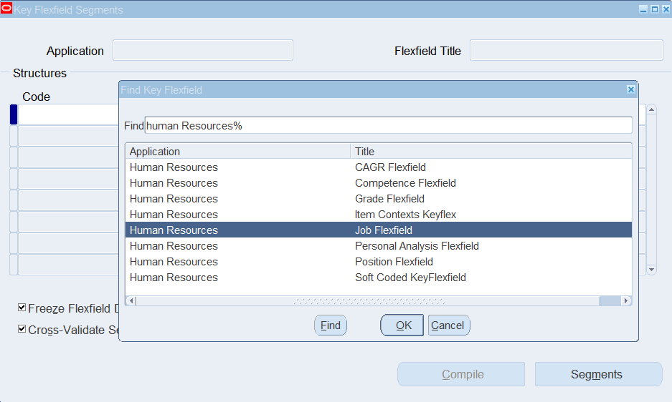
FOR A BUSINESS GROUP, THERE ARE 7 KEY FLEXFIELDS
1. HUMAN RESOURCES – JOB FLEXFIELD 2. HUMAN RESOURCES – POSITION FLEXFIELD 3. HUMAN RESOURCES – GRADE FLEXFIELD 4. HUMAN RESOURCES – COMPETENCE FLEXFIELD 5. PAYROLL – PEOPLE GROUP 6. PAYROLL – COST ALLOCATION
7. PAYROLL – BANK DETAILS KEY FLRXFIELD
SETTING UP BUSINESS GROUP WORK STRUCTURE

Slide 51
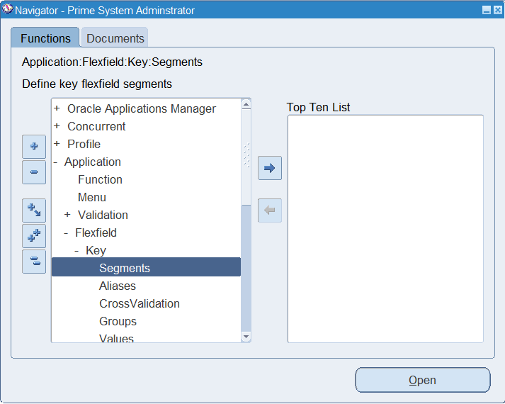
SYSTEM ADMINISTRATOR
APPLICATION
FLEXFIELD
SEGMENTS
SETTING UP BUSINESS GROUP WORK STRUCTURE

Slide 52
FOR A BUSINESS GROUP, THERE ARE 7 KEY FLEXFIELDS
1. HUMAN RESOURCES – JOB FLEXFIELD 2. HUMAN RESOURCES – POSITION FLEXFIELD 3. HUMAN RESOURCES – GRADE FLEXFIELD 4. HUMAN RESOURCES – COMPETENCE FLEXFIELD 5. PAYROLL – PEOPLE GROUP 6. PAYROLL – COST ALLOCATION
7. PAYROLL – BANK DETAILS KEY FLRXFIELD
SETTING UP BUSINESS GROUP WORK STRUCTURE

Slide 53
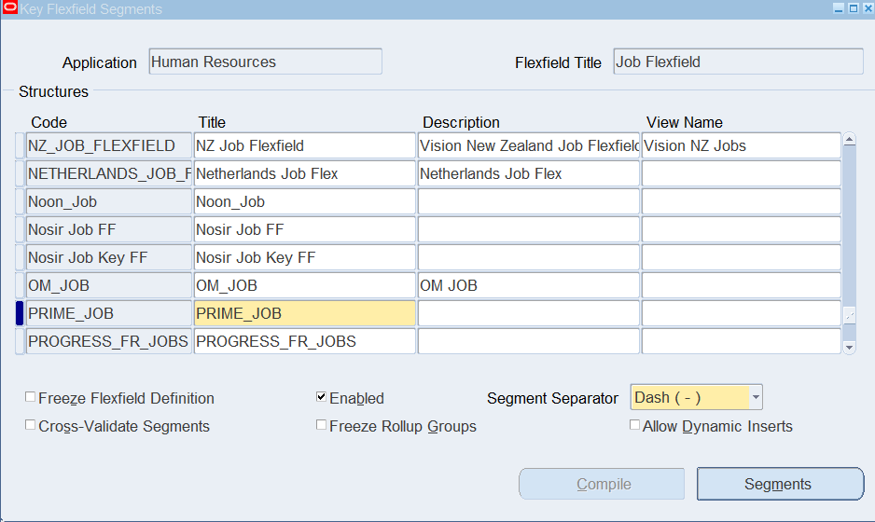
1- CREATE PRIME JOB FLEXFIELD

Slide 54
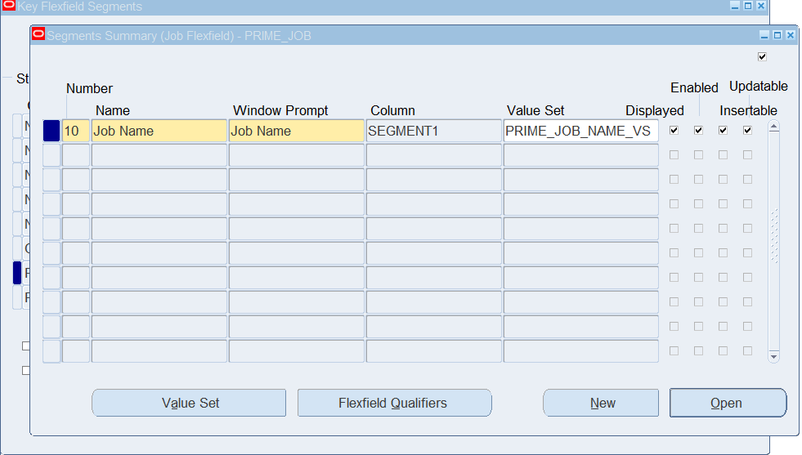
2. ADD SEGMENTS TO THE FLEXFIELD WHERE INFORMATION SHALL BE FILLED OUT

Slide 55
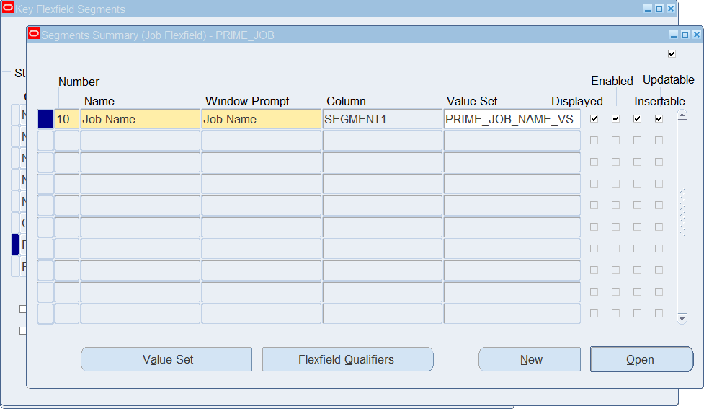
P.S. USER CAN CREATE A VALUE SET AND INSERT SPECIFIC VALUES INTO IT THAT THE USER CAN ONLY CHOOSE FROM.
HOW? THERE ARE 3 WAYS:
FROM THE BUTTON “VALUE SET” IN THE FLEXFIELD DETAIL’S WINDOW.

Slide 56
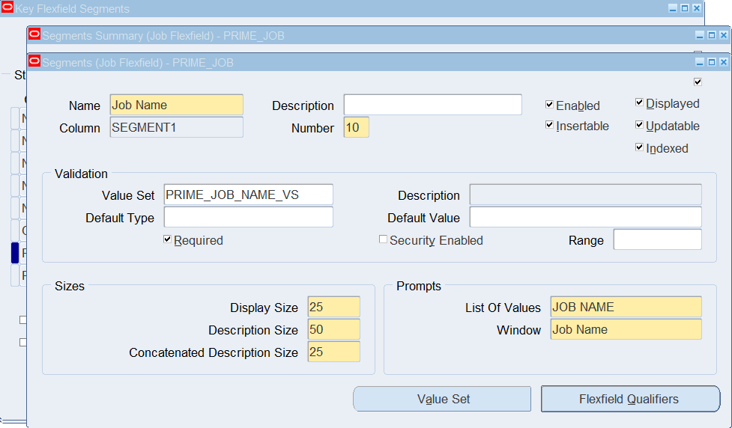
2. FROM THE BUTTON “VALUE SET” IN THE SEGMENT’S DETAILS WINDOW.

Slide 57
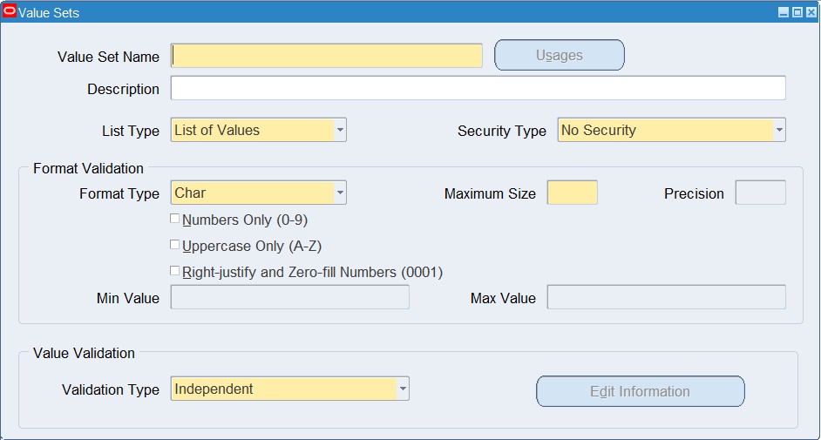
3. FROM THE NAVIGATOR:
SYSTEM ADMINISTRATOR > APPLICATION > VALIDATION > SET

Slide 58
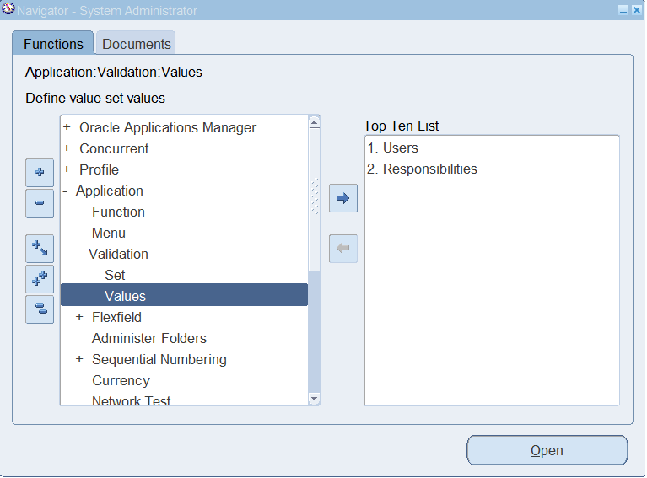
TO ADD VALUES IN CREATED VALUE SETS:
SYSTEM ADMINISTRATOR > APPLICATION > VALIDATION > VALUES

Slide 59
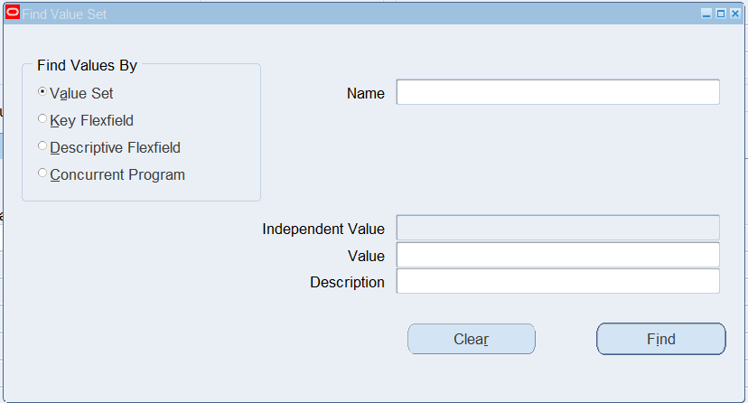
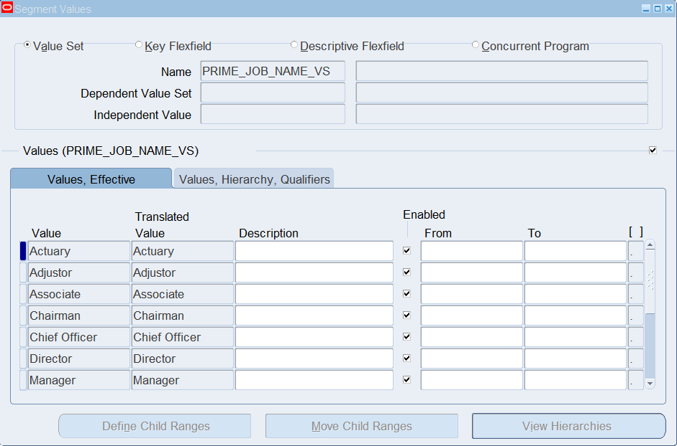
SEARCH FOR CREATED VALUE SET NAME THEN START LISTING THE VALUES

Slide 60
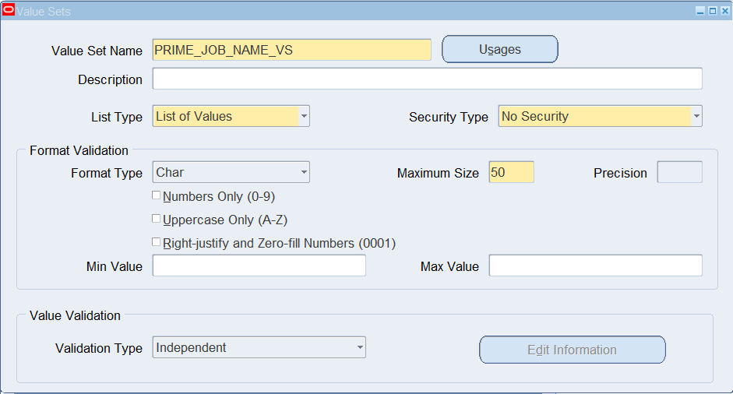
FOR THE JOB FLEXFIELD, WE ARE CREATING A VALUE SET WHERE ALL JOB NAMES SHALL BE INCLUDED.

Slide 61
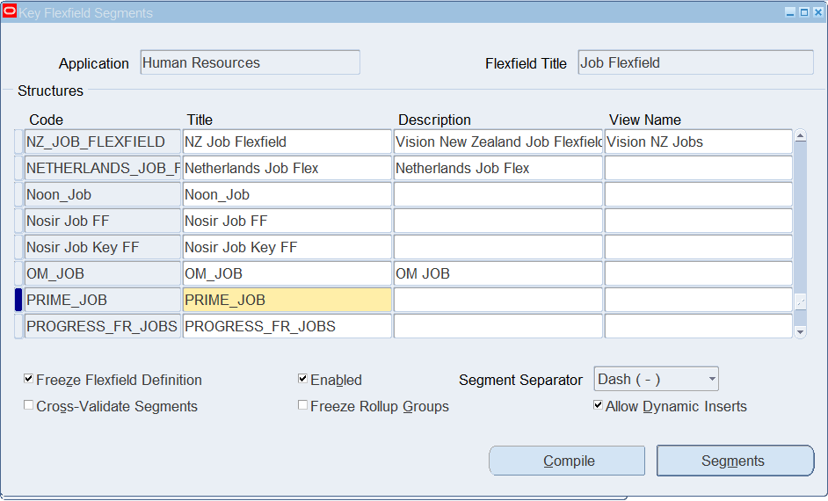
2
MAKE SURE TO CHECK FREEZE FLEXFIELD DEFINITION AND ALLOW DYNAMIC INSERTS CHECKBOXES TO SECURE THEM AGAINST EDITING.
CURRENCY

Slide 62
2
MAKE SURE TO CHECK FREEZE FLEXFIELD DEFINITION AND ALLOW DYNAMIC INSERTS CHECKBOXES TO SECURE THEM AGAINST EDITING.
CURRENCY

Slide 63
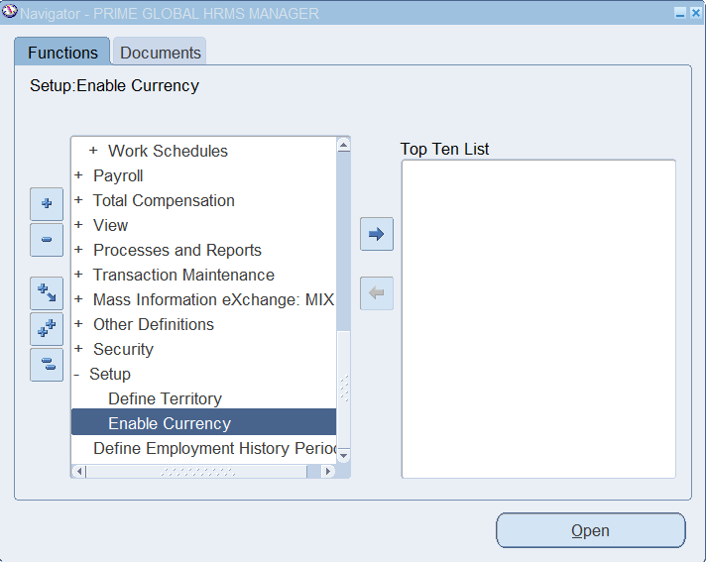
2
MAKE SURE TO ENABLE YOUR COUNTRY’S CURRENCY THAT WILL BE USED WITHIN THE BUSINESS GROUP.
HRMS > SETUP > ENABLE CURRENCY
CURRENCY

Slide 64
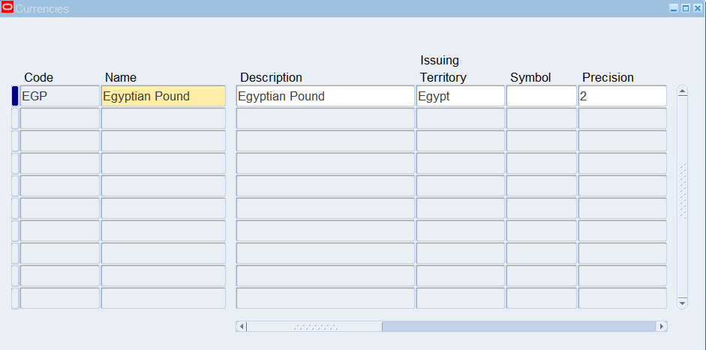
MAKE SURE TO ENABLE YOUR COUNTRY’S CURRENCY THAT WILL BE USED WITHIN THE BUSINESS GROUP.
HRMS > SETUP > ENABLE CURRENCY

Slide 65
3
LOCATION

Slide 66
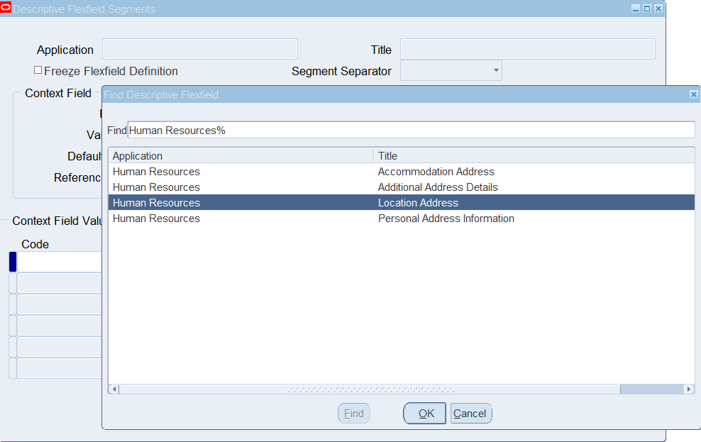
THERE ARE 2 STEPS TO DEFINE A BUSINESS GROUP LOCATION
DEFINE ADDRESS STYLE DESCRIPTIVE FLEXFIELD
DEFINE TERRITORY
ADD LOCATION

Slide 67
DESCRIPTIVE FLEXFIELDS ARE OPTIONAL FIELDS FOR USERS TO ADD MORE SPECIFIC/CUSTOMIZED INFORMATION.
1. DEFINE ADDRESS STYLE DFF.
1.1 SYSTEM ADMINISTRATOR > APPLICATION > FLEXFIELD > DESCRIPTIVE > SEGMENTS.
APPLICATION: HUMAN RESOURCES – LOCATION ADDRESS

Slide 68
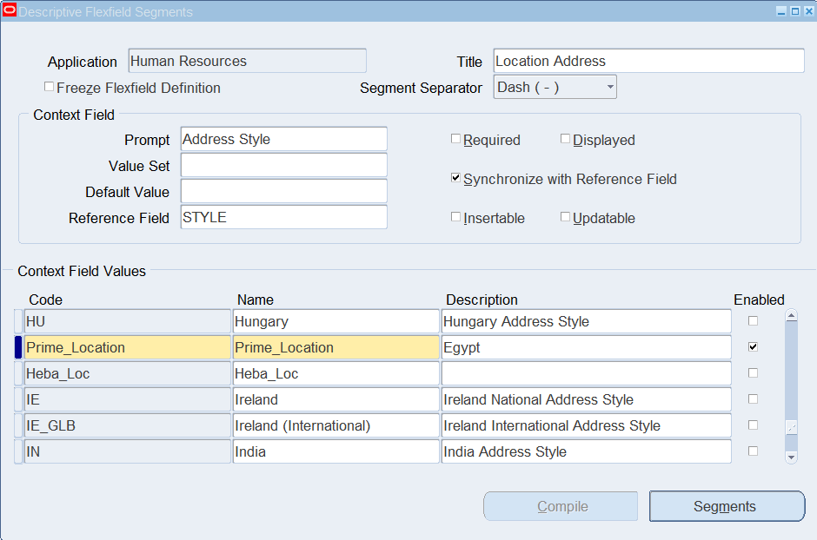
CREATE THE DESCRIPTIVE FLEXFIELD

Slide 69
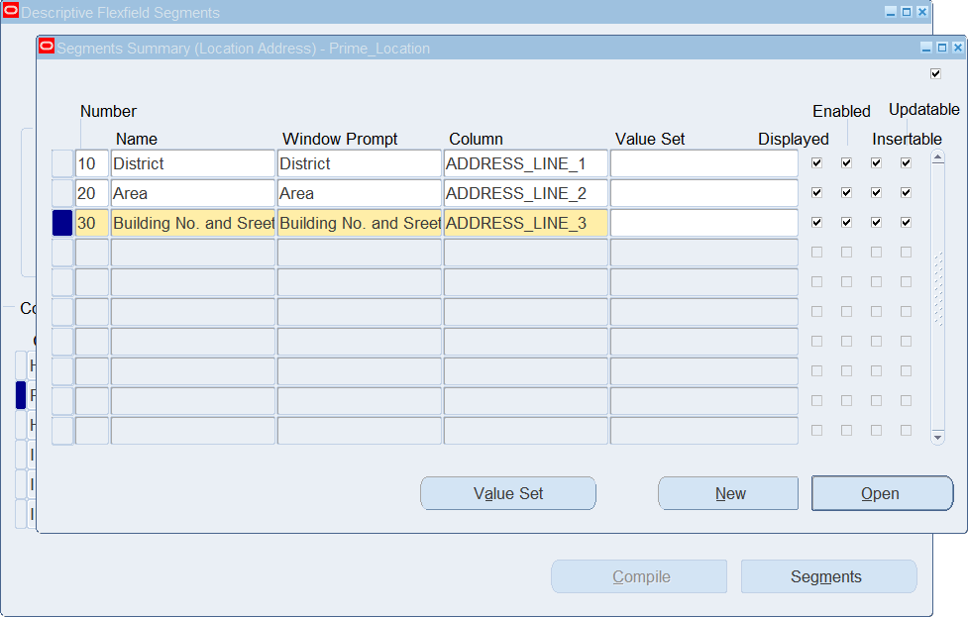
CREATE THE SEGMENTS

Slide 70
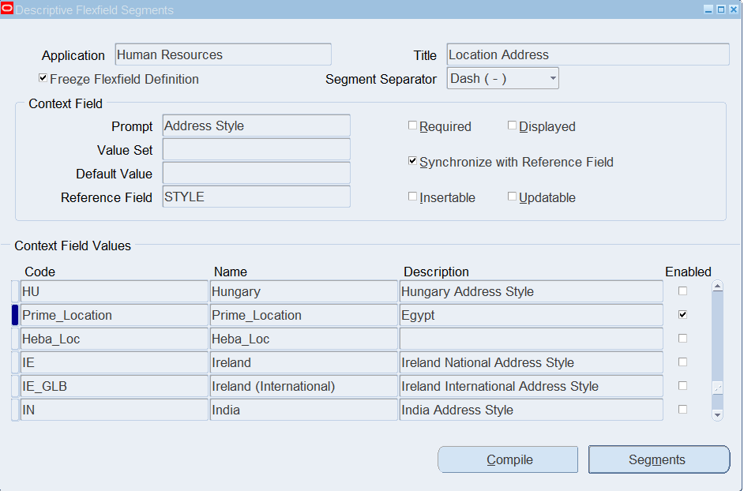
MAKE SURE TO CHECK FREEZE FLEXFIELD DEFINITION AFTER YOU ARE DONE TO AVOID ANY MORE EDITS
THEN PRESS ON COMPILE

Slide 71
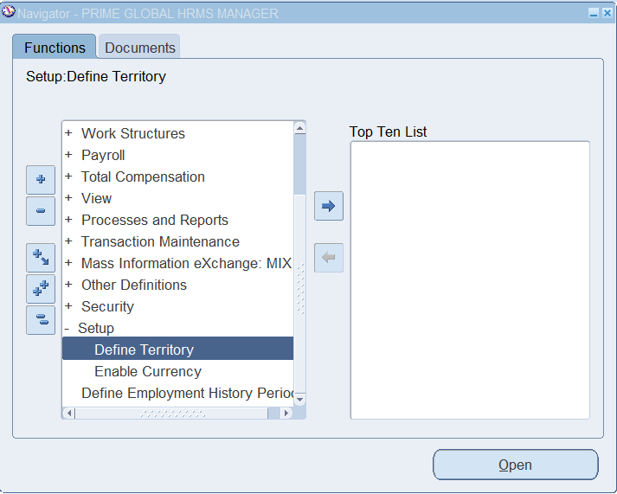
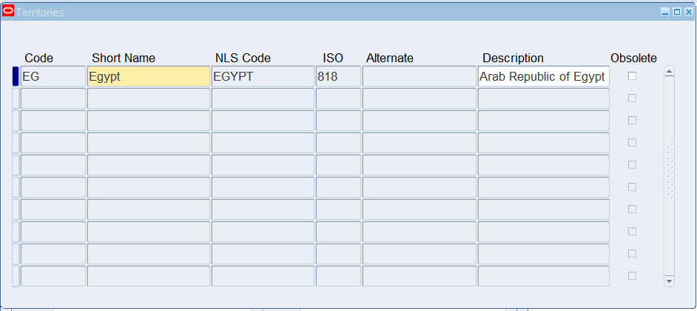
2. Define Territory
HRMS > Setup > Define Territory

Slide 72
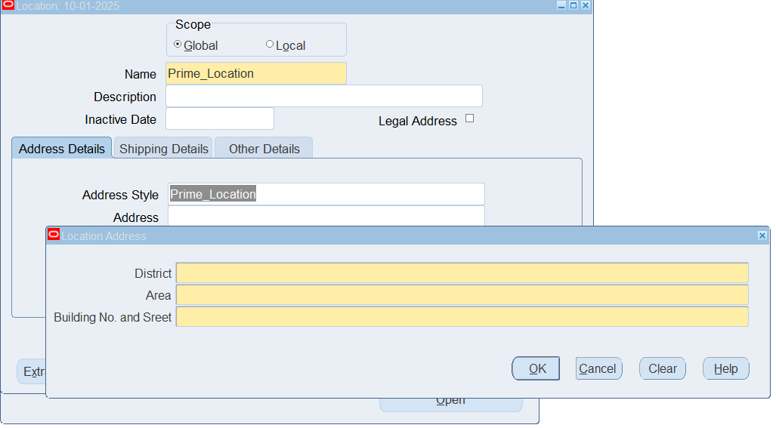
3. ADD BUSINESS GROUP LOCATION
HRMS > WORK STRUCTURES > LOCATION

Slide 73

NOW BUSINESS GROUP IS READY TO BE DEFINED!

Slide 74
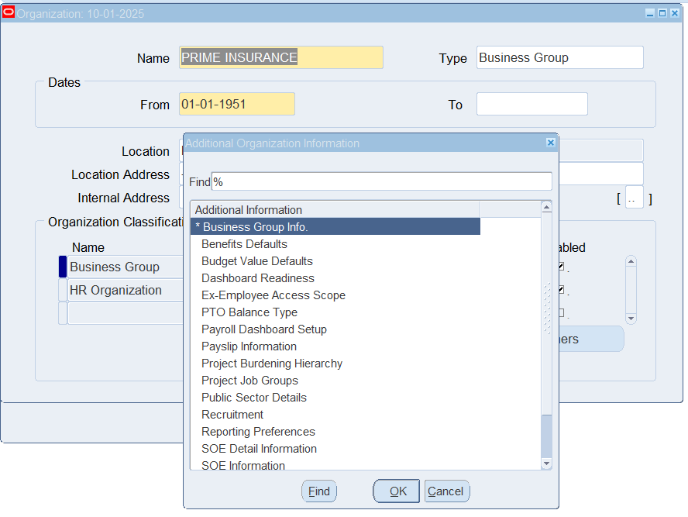
To Define Business Group:
HRMS > WORK STRUCTURES > ORGANIZATION > DESCRIPTION
1. Add BG Name, Type, and Creation Date
2. Add Organization Classification: . Business Group
. HR Organization (In case employees will be assigned to it) (Check Enabled)
3. Select Business Group classification and press on Others button to fill out Business Group Info (the pre-defined flexfields)

Slide 75
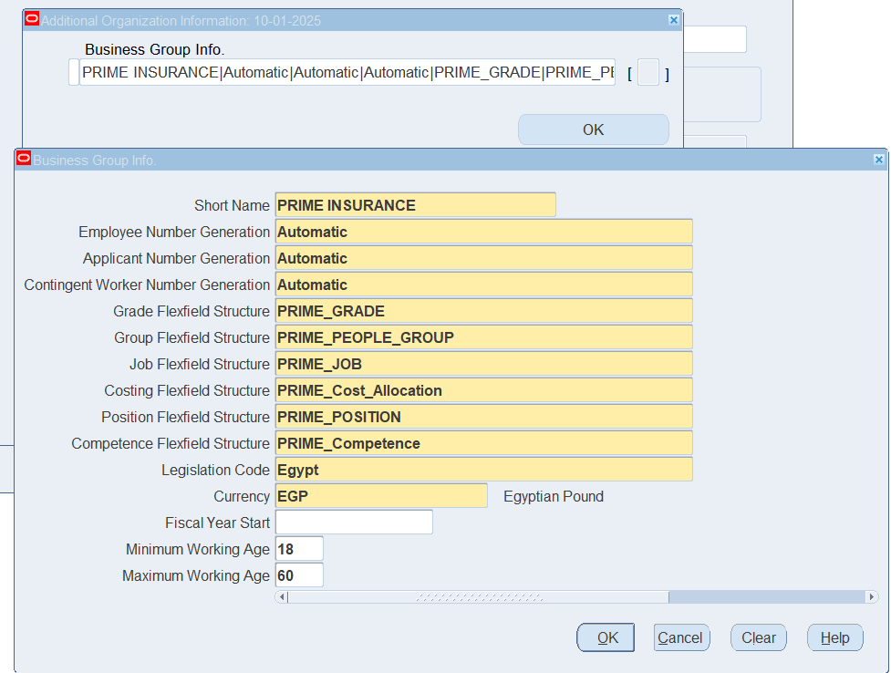
FILL OUT THE INFORMATION USING THE PRE-DEFINED FLEXFIELDS

Slide 76

LINK BUSINESS GROUP TO RESPONSIBILITY

Slide 77
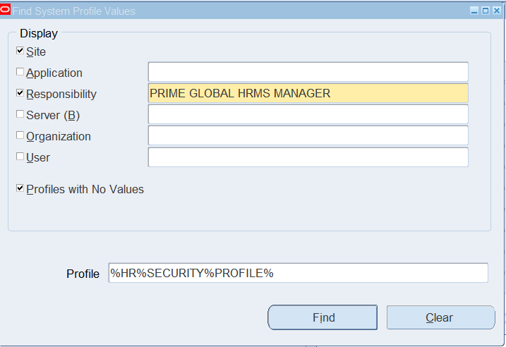
System Administrator > Profile > System
Select the Responsibility checkbox and enter the name of the responsibility
Enter HR:Security Profile (%HR%SECURITY%PROFILE%) in Profile Field and press on Find

Slide 78
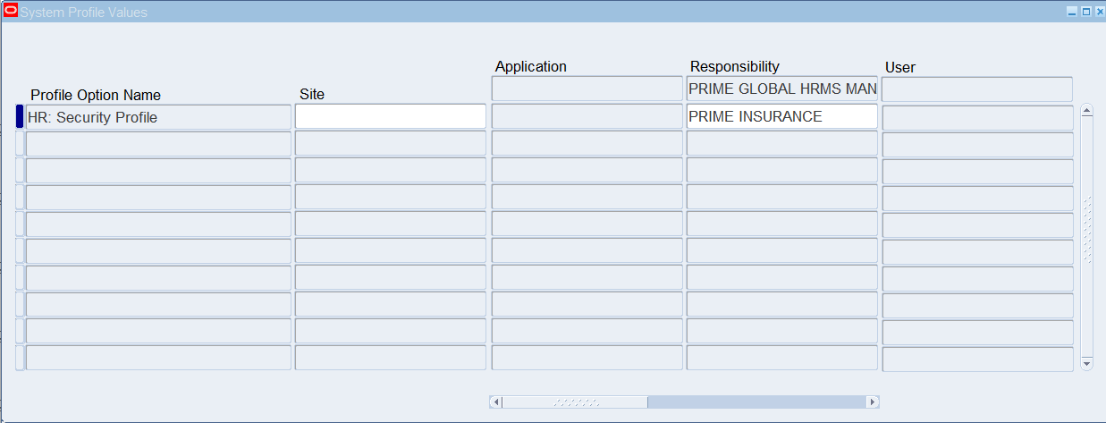
Choose Business Group Name under Responsibility Name

Slide 79
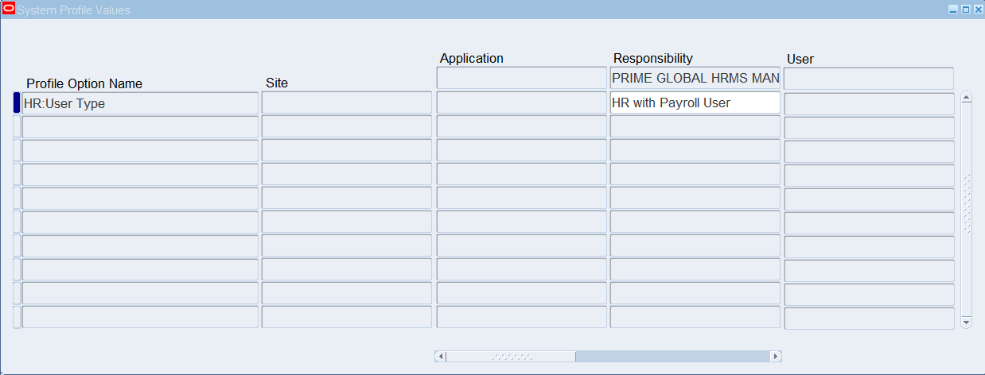
Return to the Find Window and query the HR:User Type profile (%HR%USER%TYPE%)
Choose HR with Payroll User

Slide 80

TIME TO DEFINE INTERNAL DEPARTMENTS, JOBS, GRADES AND POSITIONS!

Slide 81
2
GRADES
1
3
DEPARTMENTS
JOBS
4
POSITIONS

Slide 82
1
DEPARTMENTS

Slide 83
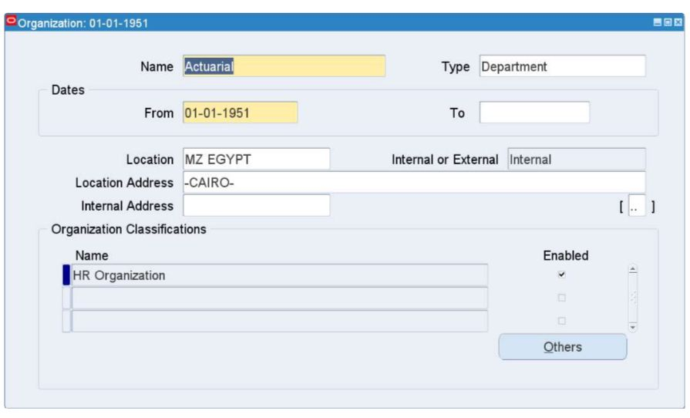
For Prime Insurance, there are several internal departments including: Claims, Underwriting, Actuarial, Marketing, Sales, Human Resources, etc.
HRMS > Work Structures > Organization > Description > New
Add Department Name, Type, Location, and Classification

Slide 84
2
GRADES

Slide 85
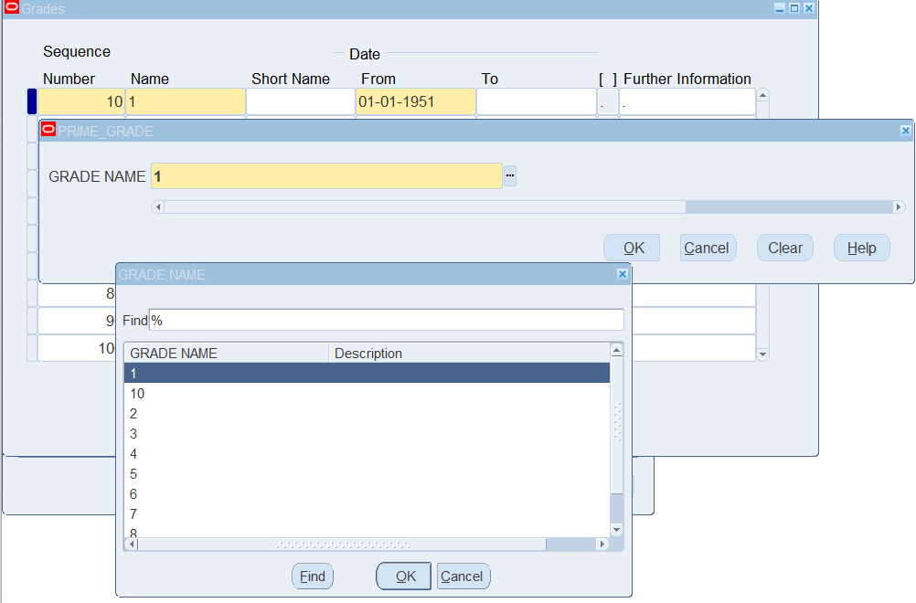
Defining Grades, Jobs, and Position is a bit different because these values has already been entered into their appropriate value sets.
Defining Grades:
HRMS > Work Structures > Grade > Description
Press on Grade Name Value Set, it opens the created Grade Flexfield, and users shall choose from the predefined value set each and every grade to be defined to the business group to be active for use

Slide 86
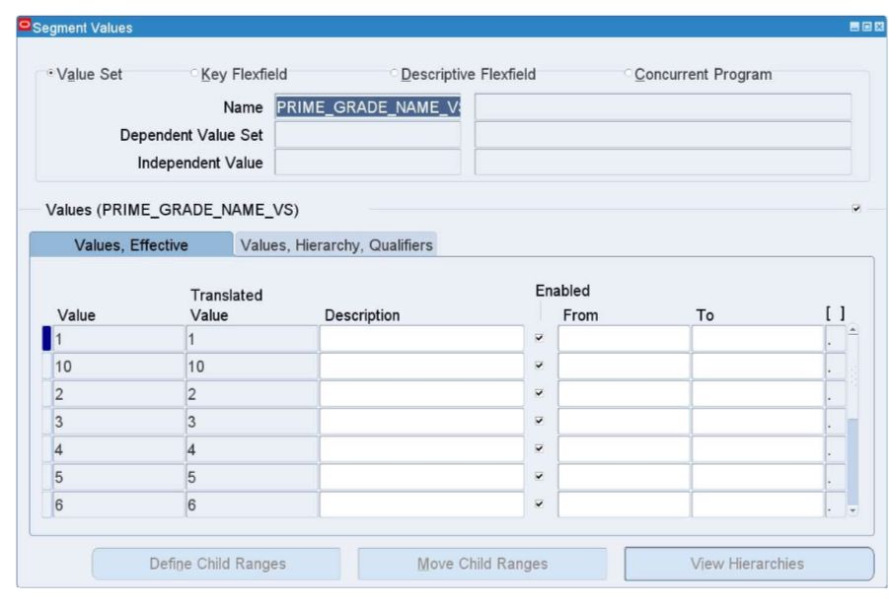
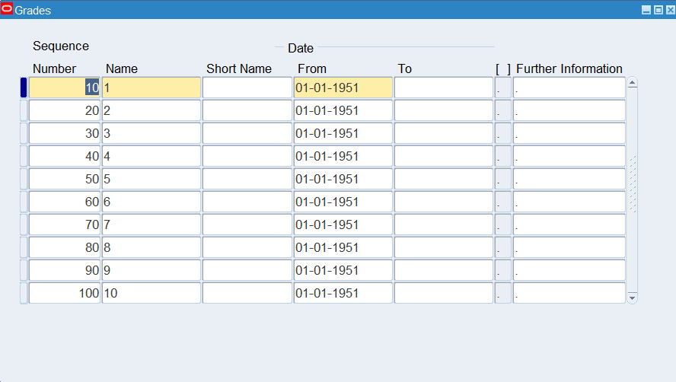
Repeat until you define all list values.

Slide 87
3
JOBS

Slide 88
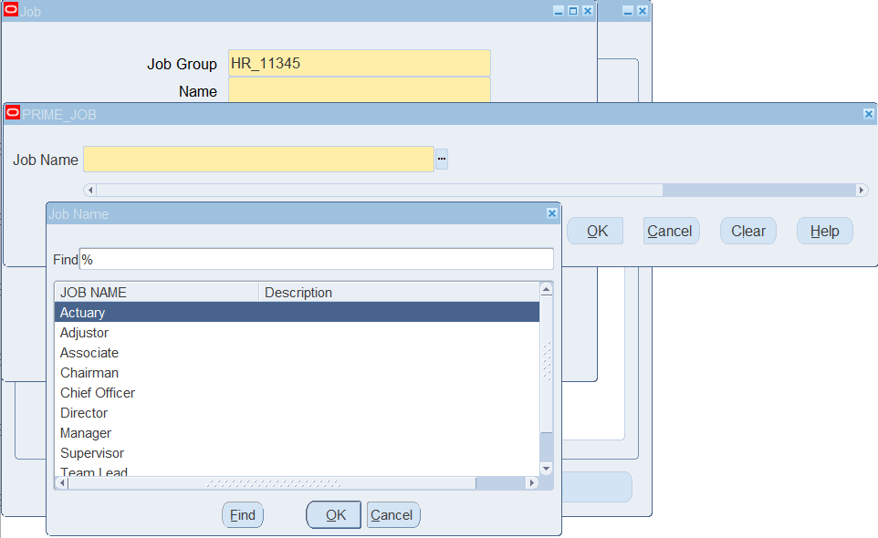
HRMS > Work Structures > Job > Description > New
Press on Job Name value set, it opens the created Job flexfield, and user shall choose from the predefined value sets each job to be defined to the business group to be active for use

Slide 89
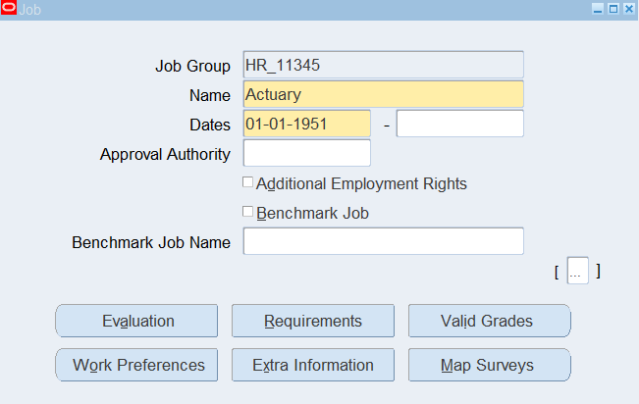
Repeat until you define all list values.
For defining a job, user can specify certain grade for each from “Valid Grades” button.
There can also be extra information and special information for each job that could be filled out through Extra Information and Requirements buttons respectively.

Slide 90
4
POSITIONS

Slide 91
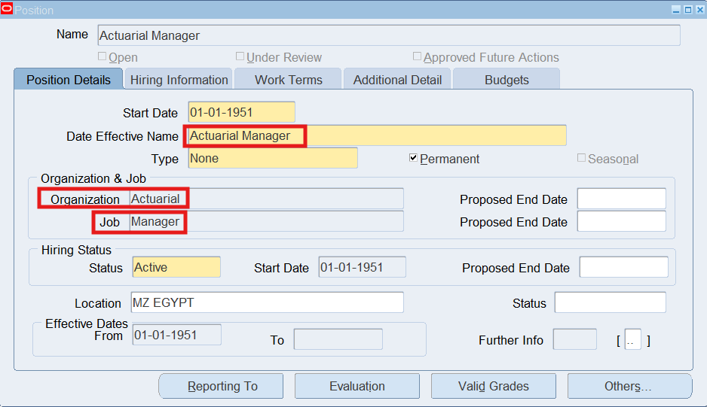
Position = Organization + Job
EX. Actuarial Manager = Actuarial + Manager
HRMS > Work Structures > Position > Description
It is important to choose the correct position name, organization, and job from the predefined value sets.
Repeat until you define all list values.

Slide 92

ORGANIZATIONAL HIERARCHY

Slide 93
HRMS > Work Structures > Organization > Hierarchy

Slide 94
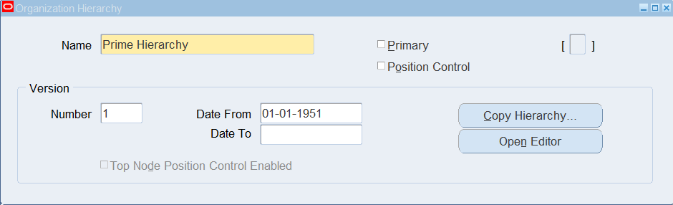
To display it:
HRMS > Work Structures > Organization > Diagrammer
Choose previously created Hierarchy Name
Press on Open Editor

Slide 95
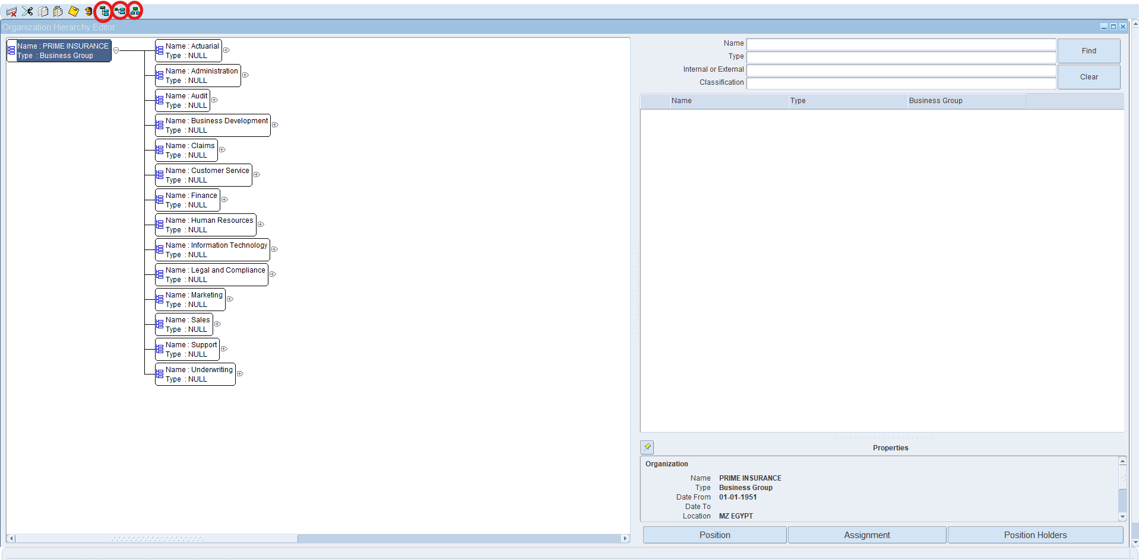
Hierarchy can be displayed in different layouts: Vertical Style, Interleaved Style, or Org-Chart Style

Slide 96

POSITION HIERARCHY

Slide 97
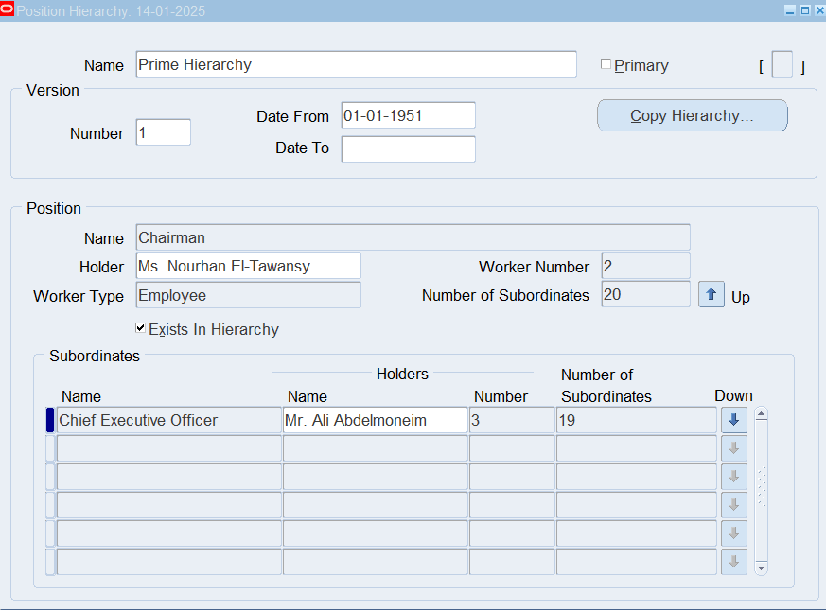
HRMS > Work Structures > Position > Hierarchy

Slide 98
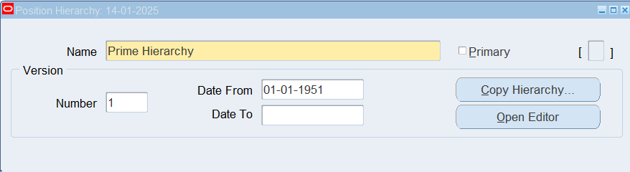
To display it:
HRMS > Work Structures > Position > Diagrammer
Choose previously created Hierarchy Name
Press on Open Editor

Slide 99
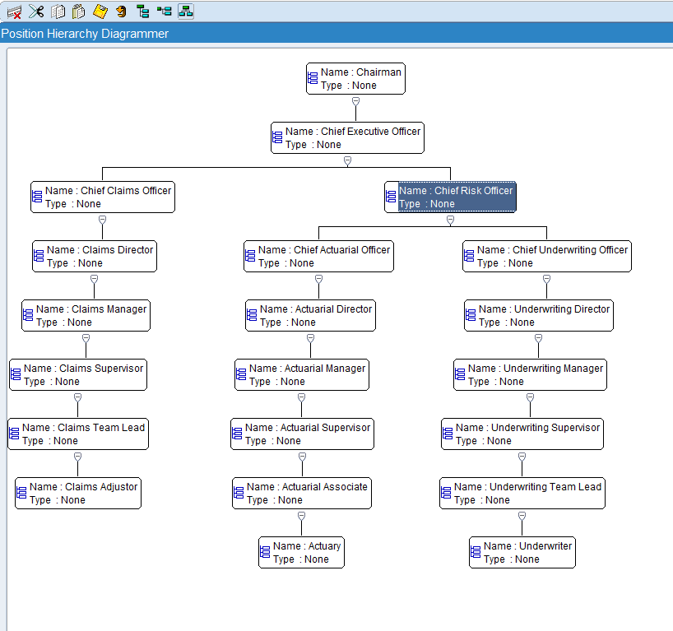
Hierarchy can be displayed in different layouts: Vertical Style, Interleaved Style, or Org-Chart Style

Slide 100

PEOPLE ONBOARDING AND MANAGEMENT

Slide 101

CUSTOMIZATION FOR BEST UTILIZATION!

Slide 102
1
2
3
4
ADDRESS STYLE
NAME FORMAT
PERSON TYPES
LOOKUPS
5
6
7
SPECIAL INFO TYPE (SIT)
EXTRA INFO TYPE (EIT)
MEDICAL ASSESSMENT

Slide 103
1
PERSON TYPES

Slide 104
This categorizes people to employees, applicants, candidates, referrals, etc.
Each company can customize its own list
HRMS > Other Definitions > Person Types

Slide 105
Add Person Type Name

Slide 106
2
LOOKUPS

Slide 107
HRMS > Other Definitions > Application Utilities Lookups
Press Ctrl + F11 to look for the lists you want to edit/customize
For example, search for Nationality

Slide 108
Or Marital Status

Slide 109
3
ADDRESS STYLE

Slide 110
Remember Business Group Location?
Create Descriptive Flexfield
System Administrator > Application > Flexfield > Descriptive > Segments
Application: Human Resources – Personal Address Information

Slide 111
Add Segments
Save and press on Compile

Slide 112
4
Name Format

Slide 113
Last Name, First Name
First Name Last Name
First,
HRMS > Other Definitions > Person Name Formats
This opens a web page, press on Create Name Format button

Slide 114
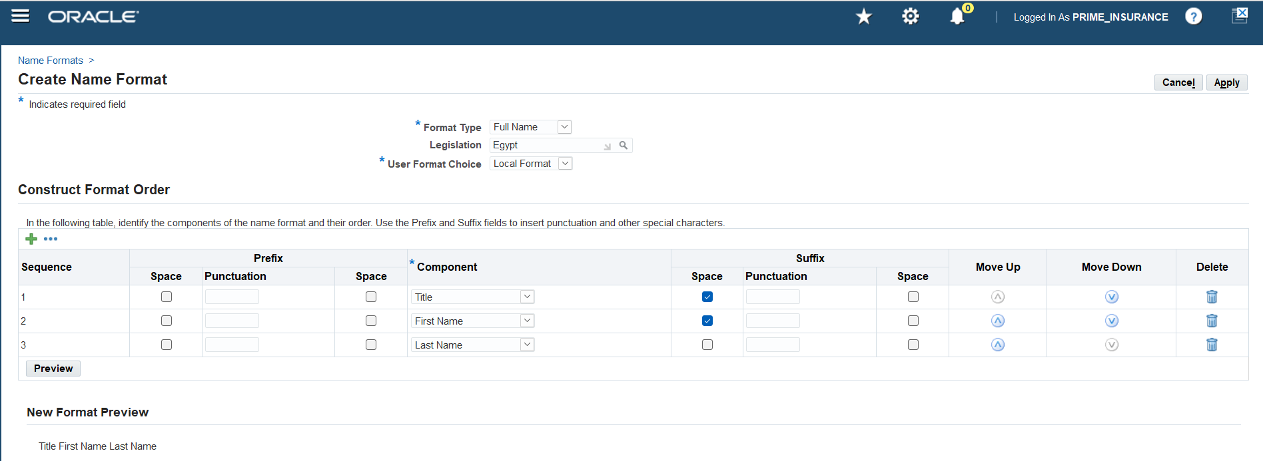
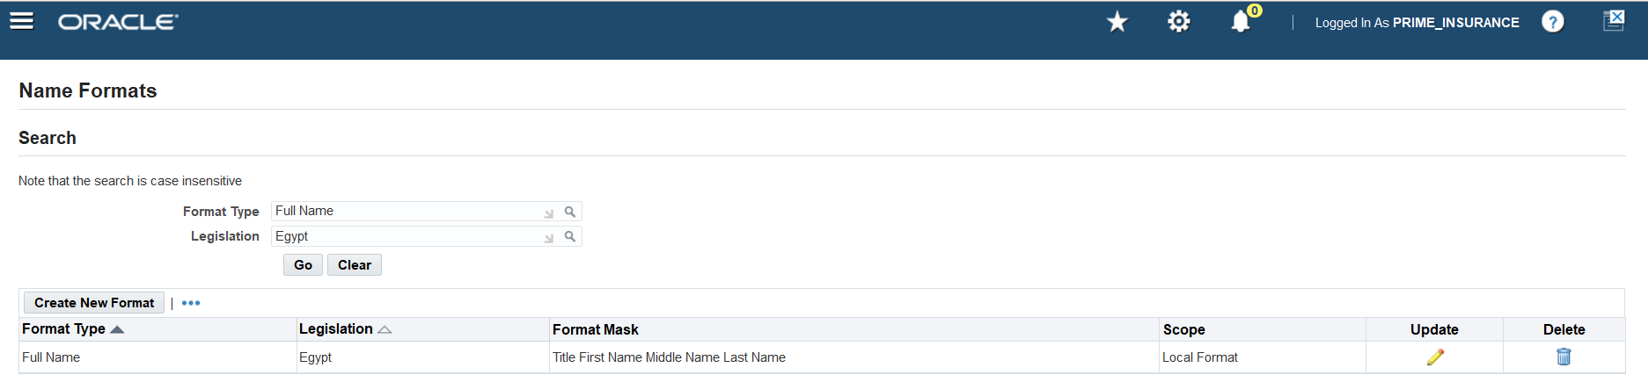
Choose the format and legislation
Create the sequence for the name format

Slide 115
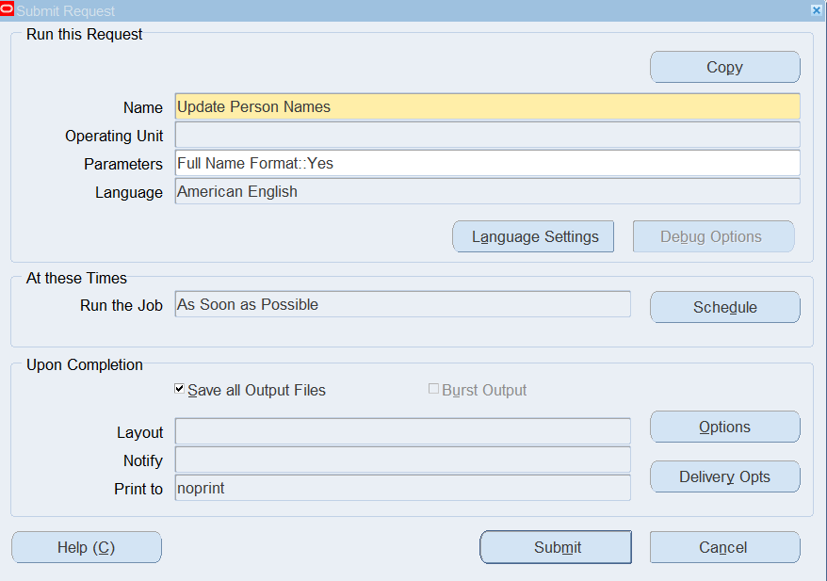
Second,
View > Requests > Submit a New Request
Name: Update Person Names
Format Type: Full Name Format

Slide 116
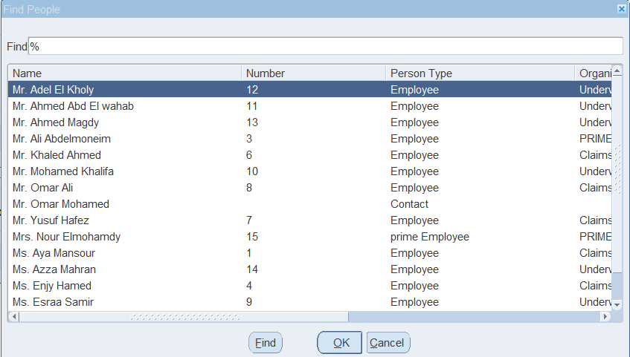
Once request is completed, the new format shall be applied already

Slide 117
5
SPECIAL INFO TYPE (SIT)

Slide 118
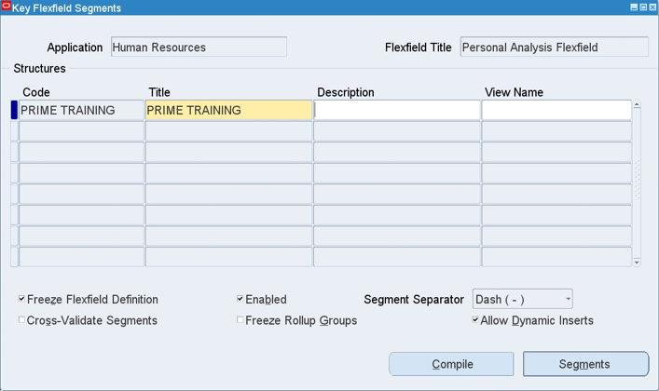
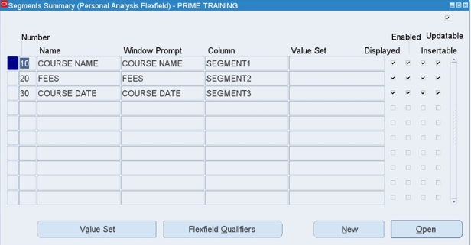
There are 2 steps to set up Special Information Type
1. Create Key Flexfield
System Administrator > Application > Flexfield > Key > Segments
Application: Human Resources - Personal Analysis Flexfield

Slide 119
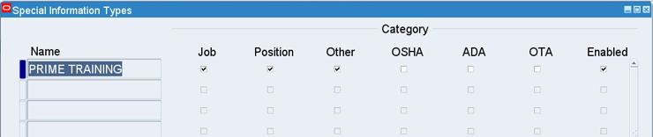
2. Choose which windows this flexfield should appear on
HRMS > Other Definitions > Special Information Type

Slide 120
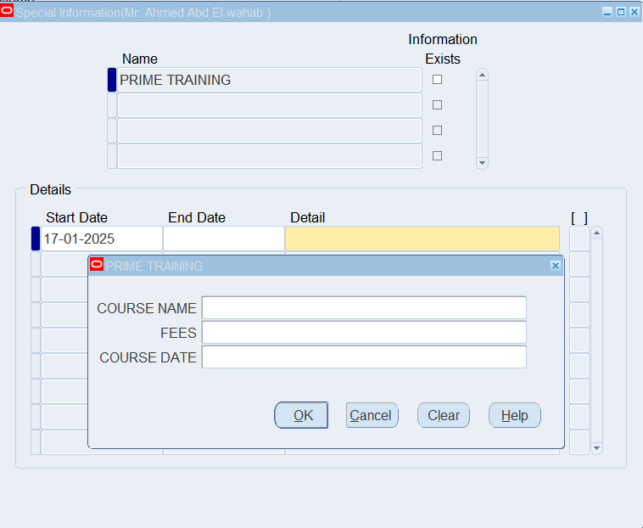
Special Information Type appears here:
HRMS > Work Structure > Job > Description > Requirements Button
HRMS > Work Structure > Position > Description > Others Button > Requirements
HRMS > People > Enter and Maintain > People Window > Special Info Button

Slide 121
6
EXTRA INFO TYPE (EIT)

Slide 122
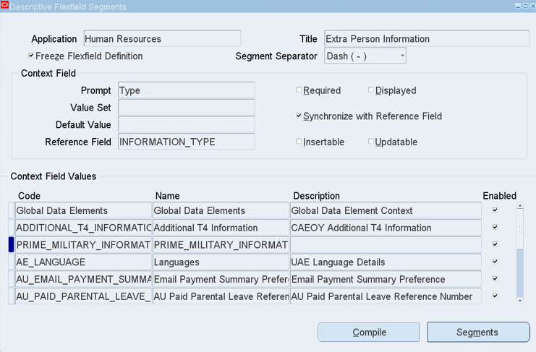
There are 3 steps to set up Extra Information Type
1. Create Descriptive Flexfield
System Administrator > Application > Flexfield > Descriptive > Segments
Application: Human Resources - Extra (Person/Assignment/Job/etc.) Information

Slide 123
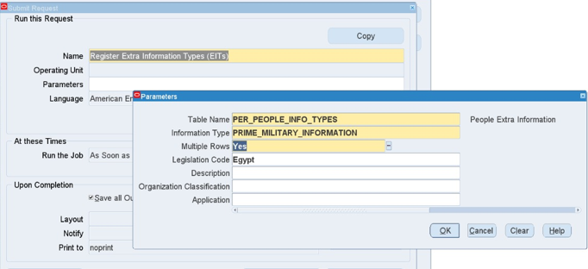
2. Run Request
View > Requests > Submit a New Request
Name: Register Extra Information Type
Parameter: Extra Information - window DFF was created for (People/Assignment/Job/etc.)

Slide 124
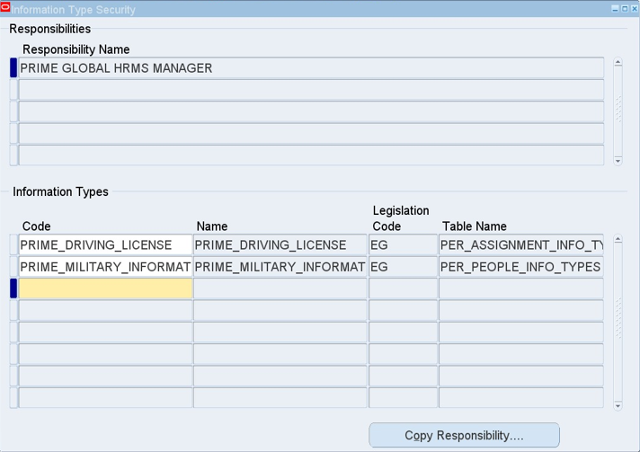
3. Assign to Responsibility
HRMS > Security > Information Types Security
F11 to search for Responsibility Name
Information Types:
F11 to search for created descriptive flexfields

Slide 125
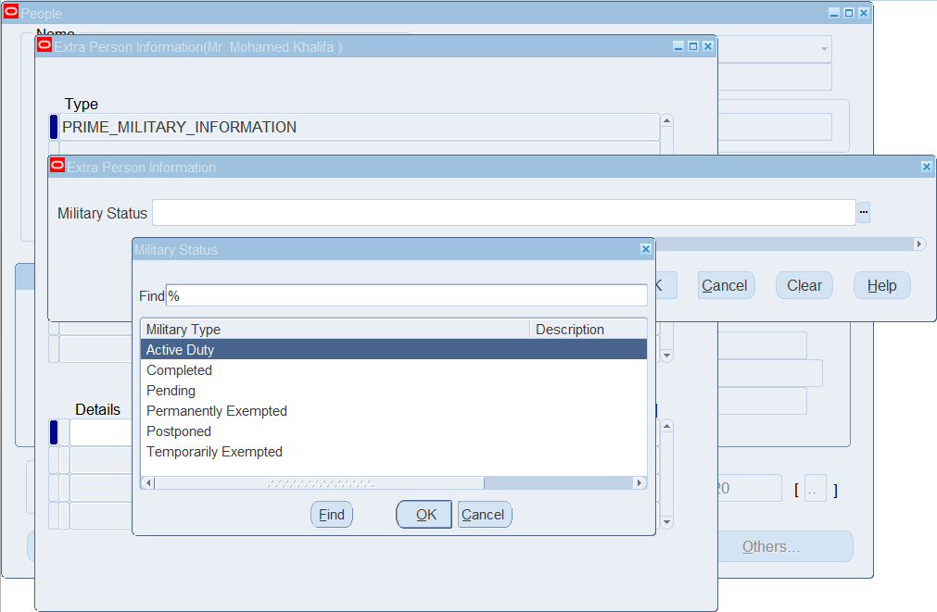
The one created for People shall appear in People window
People Window > Others Button > Extra Information

Slide 126

and the one created for assignment shall appear in Assignment window
People Window > Assignment Button > Others Button > Extra Information

Slide 127
7
MEDICAL ASSESSMENT

Slide 128

Define Medical Provider Organization
HRMS > Work Structures > Organization > Description
Add Organization Name
Classification: Medical Service Provider

Slide 129

To add it to employees:
HRMS > People > Enter and Maintain > People Window > Others Button > Medical Assessments

